Slide 1


Early prediction of Sepsis Using Clinical data
Sree Sarada Alapaty
HAP 780, G01440615
Dr. Sanja Avramovic

Slide 2
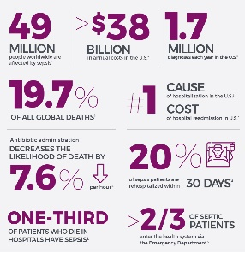
Introduction:
Sepsis is a life-threatening infection reaction that can result in organ failure or even death.
Each year, 270,000 fatalities are attributed to this phenomenon in the United States, with 1.7 million individuals being affected. On a global scale, it affects 30 million people and leads to 6 million deaths.
The most expensive condition for US hospitals, accounting for $24 billion, or 13% of overall healthcare spending.
The mortality rate increases by 4-8% per hour due to delays in treatment.
The current advancements in diagnosis are still inadequate for the prompt detection of conditions.
Developing a machine learning model to identify sepsis early to improve the efficiency and precision of therapy.
The goal of the project is to use algorithmic innovation and data integration to increase patient survival rates and provide new care guidelines.

Slide 3
Data Source & Collection:
The MIMIC-III dataset was used, together with deidentified health data from approximately 40,000 ICU patients at Beth Israel Deaconess Medical Center between 2001 and 2012.
Data has been imported into Microsoft SQL Server to improve processing and visualization capabilities. The database contains about 1.5 million patient entries, with a focus on clinical time-series data for ICU patients.
Vital signs, laboratory values, demographic information, and outcome data are all included, with repeated measures to ensure accuracy.
Imputation is carried out on a per-patient basis to ensure the integrity of the data, which is crucial for accurate sepsis prediction given the significant number of missing values.
The dataset comprises 40,336 unique patients, highlighting the extensive size and comprehensive nature of the available data.
The objective is to identify early sepsis-onset patterns through the examination of vital signs, laboratory data, and demographic information.
From a total of 44 variables, 24 were chosen as key variables and prioritized for their robust indicators of sepsis onset and progression.

Slide 4
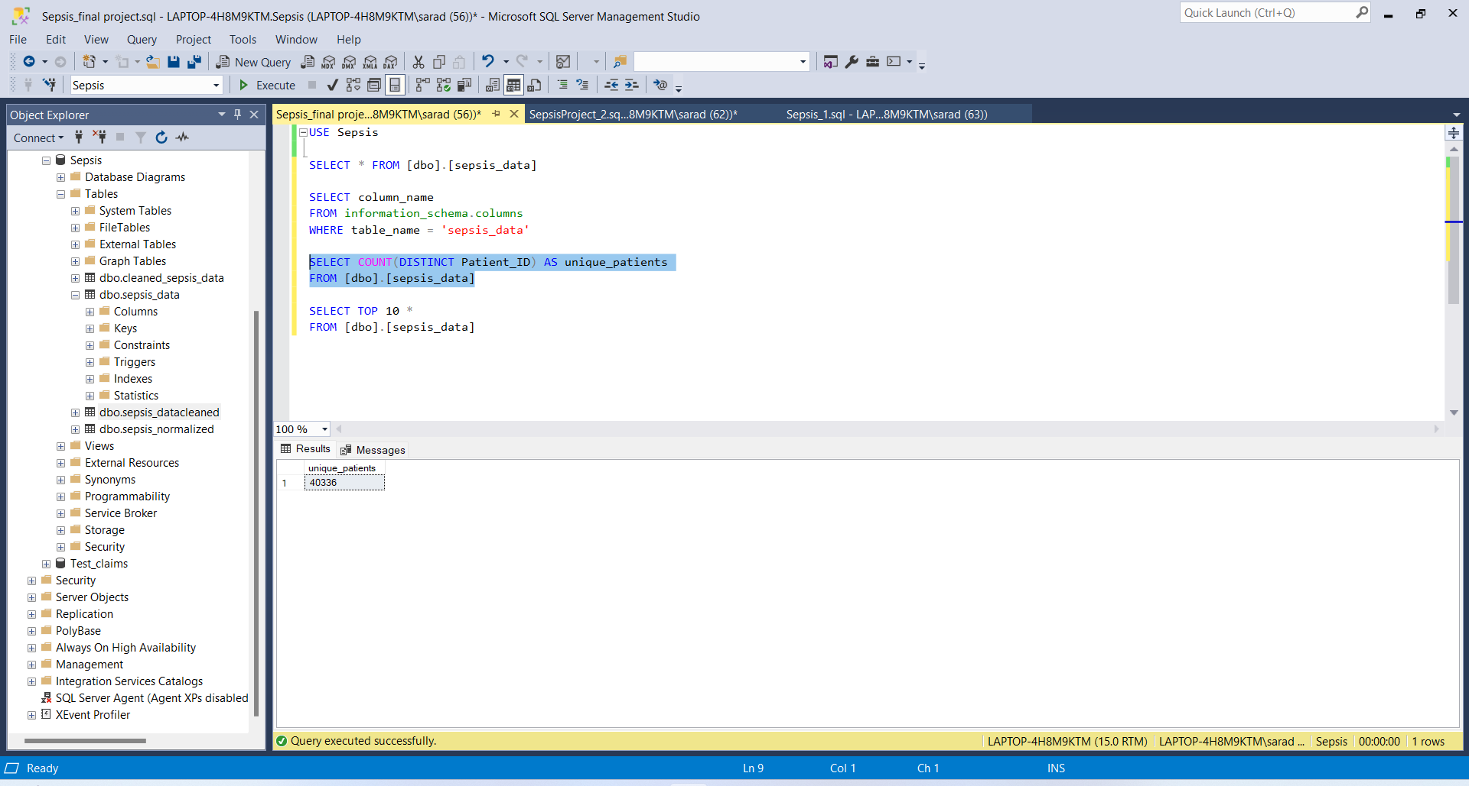
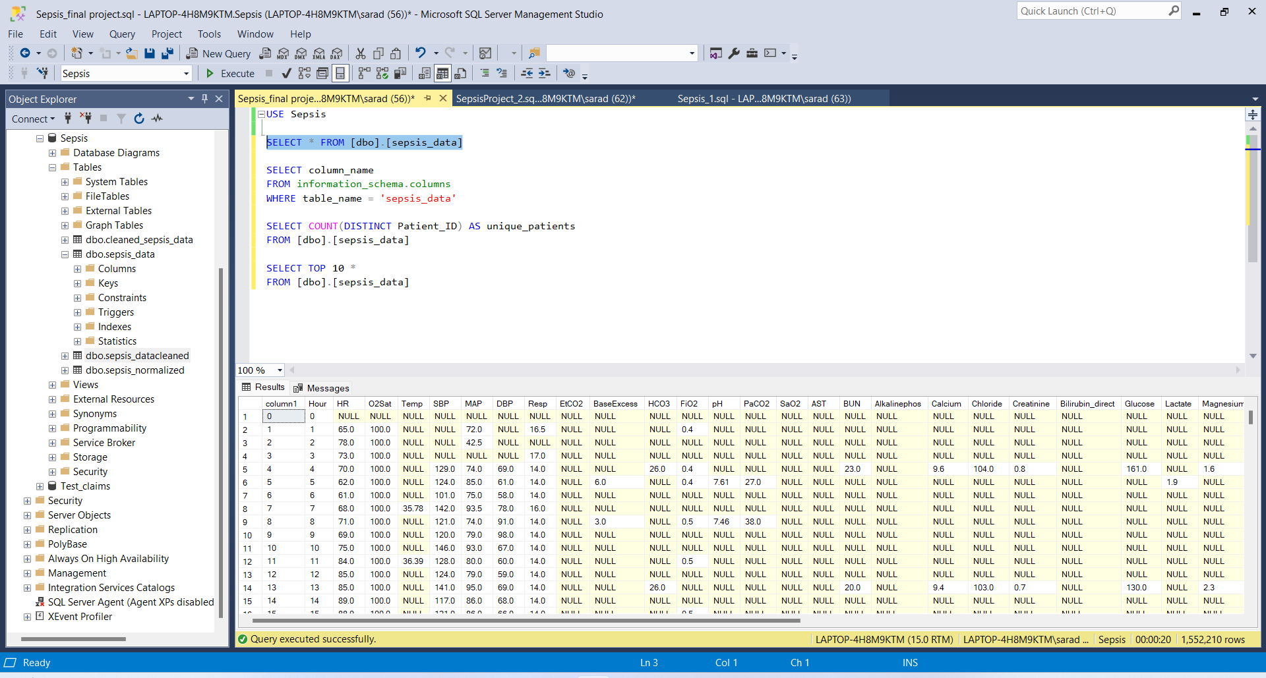

Slide 5
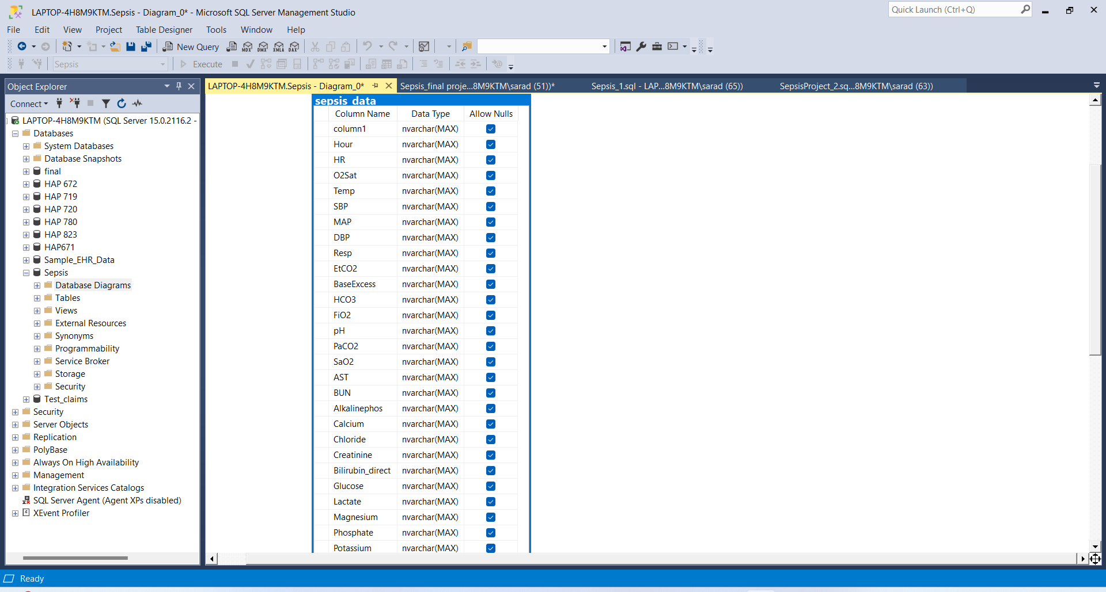
Data Preprocessing
Used the MIMIC-III dataset from a large healthcare database that focused on sepsis outcomes. It was processed using Microsoft SQL Server Management Studio (SSMS) version 20 for efficient database management, SQL queries, and scripting, making sure it works with complex medical datasets.
An Entity-Relationship Diagram (ER Diagram) was made in the SSMS to help with effective data extraction and querying by providing clarity on the organization of data.
A thorough data exploration was performed to comprehend the dataset's size and structure, including a detailed evaluation of all column names to identify relevant variables.
For accurate analysis at the patient level, the data precision was checked by counting the number of unique Patient_ID values.

Slide 6
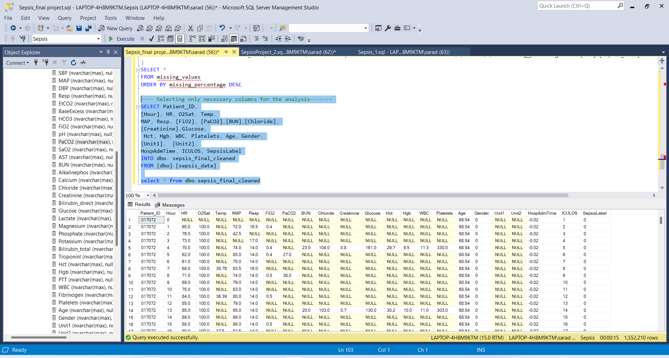
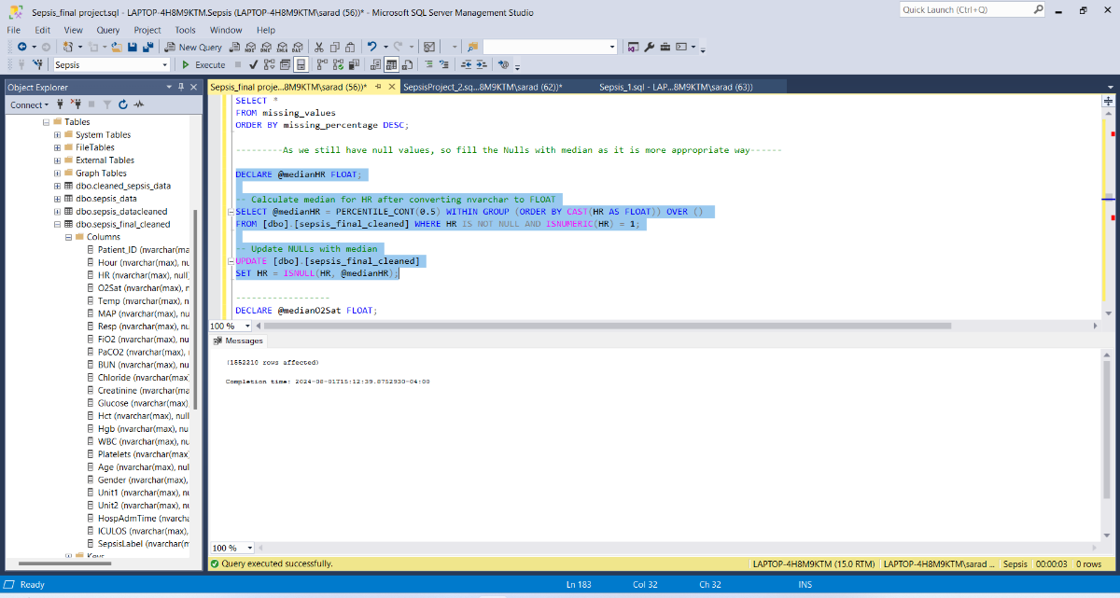
Cont.
To optimize the dataset, missing values were analyzed to find columns with significant data absence. Columns with more than 95% missing data were deleted.
I have created the dbo.sepsis_final_cleaned table, with an emphasis on the most significant and reliable data.
For continuous variables (heart rate, temperature, and mean arterial pressure, etc.), median imputation was used to manage missing values without being impacted by outliers.
Implemented mode imputation to handle missing values in categorical variables (Unit1 and Unit2), maintaining data consistency by replacing the missing values with the most often occurring categories.

Slide 7
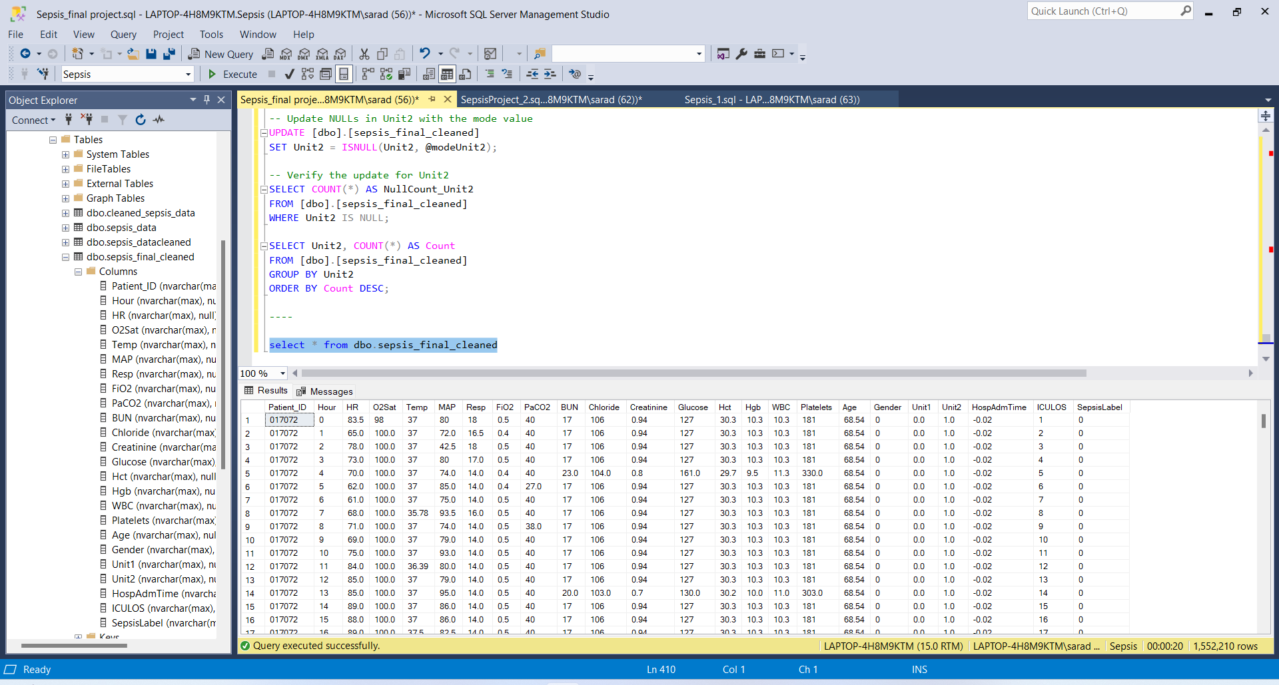
dbo.sepsis_final_cleaned

Slide 8
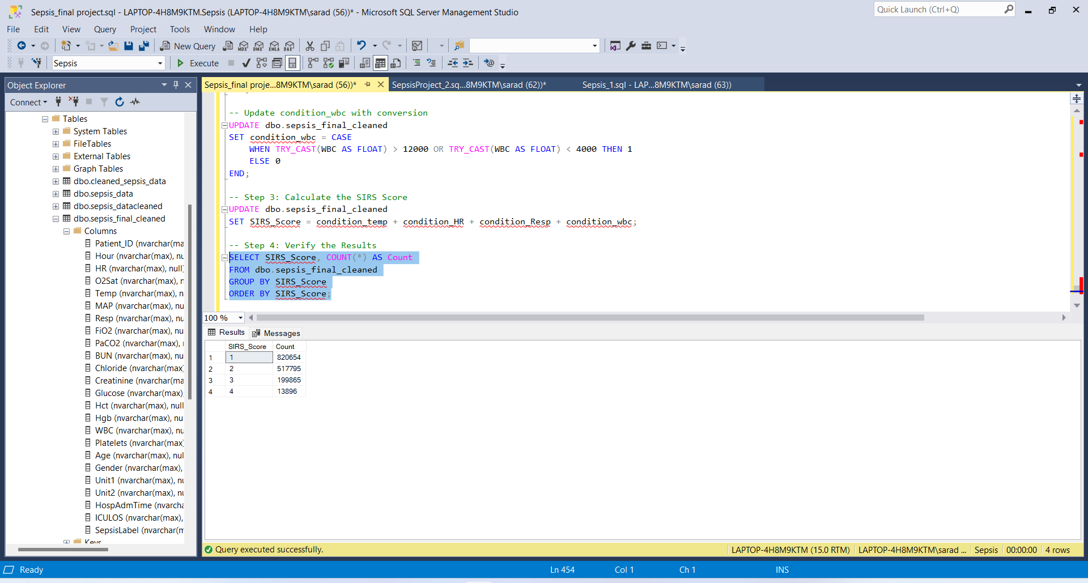
SIRS Score Analysis for Sepsis Detection
Enhanced the dbo.sepsis_final_cleaned dataset by integrating Systemic Inflammatory Response Syndrome (SIRS) criteria:
SIRS Criteria Flags: Temperature (condition_temp) set to '1' for abnormal range of 36°C-38°C indicating fever or hypothermia, Heart Rate (condition_HR) flagged above 90 bpm, Respiration Rate (condition_Resp) marked over 20 bpm or PaCO2 below 32 mmHg, White Blood Cell Count (condition_wbc) flagged outside the normal range of 4,000 to 12,000 cells per microliter.
Aggregated these flags to compute a comprehensive SIRS score for each patient, serving as an indicator of systemic inflammation:
SIRS Score Distribution: Score 1 (820,654 patients, mild inflammation), Score 2 (517,795 patients), Score 3 (199,965 patients), Score 4 (13,896 patients, severe inflammation).
Utilized SIRS scores to establish a foundation for detailed statistical analysis and predictive modeling.

Slide 9
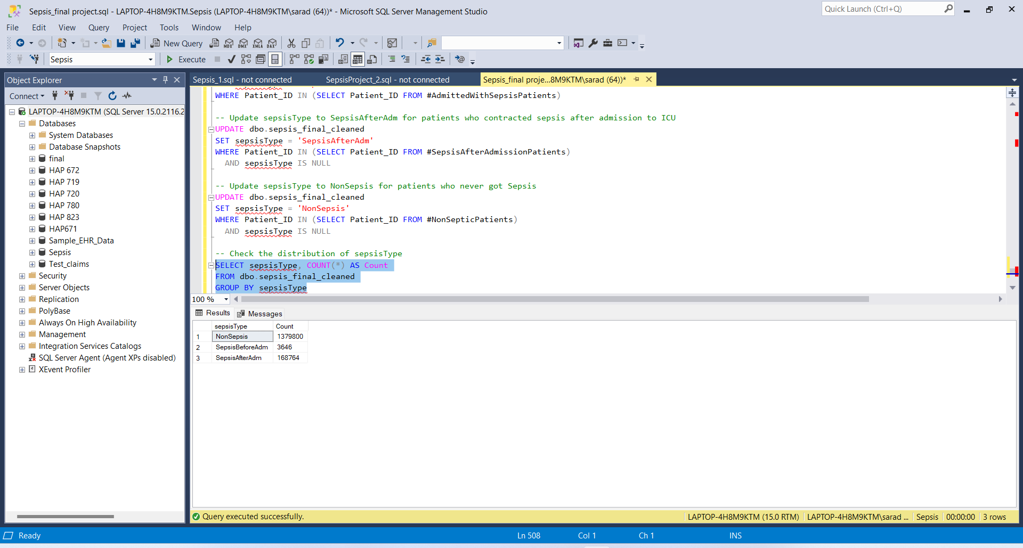
Sepsis Status Classification in ICU Patients
The data were further leveraged to classify patients based on their sepsis status at the time of admission, enhancing our analysis precision.
Patients were categorized into three groups: 'NonSepsis', totaling 1,379,800 patients who did not develop sepsis; 'SepsisBeforeAdm', including 3,646 patients admitted with sepsis; and 'SepsisAfterAdm', comprising 168,764 patients who developed sepsis after admission.
This detailed categorization allowed us to perform a targeted analysis of sepsis progression and outcomes, significantly enhancing our ability to predict and manage sepsis effectively in ICU settings.

Slide 10
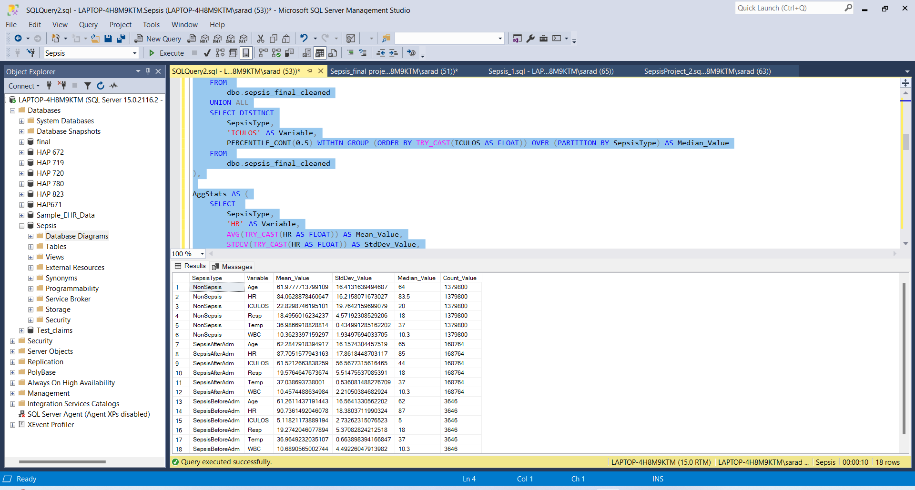
Analysis:
Using descriptive statistics, I analyzed key physiological and demographic factors such Age, Heart Rate (HR), ICU Length of Stay (ICULOS), Respiration Rate (Resp), Temperature (Temp), and White Blood Cell Count. The variables were assessed in three categories of sepsis: NonSepsis, SepsisBeforeAdm, and SepsisAfterAdm.
The patients in the SepsisAfterAdm group had much higher heart rates, longer ICULOS, and higher respiratory rates, which suggests they were under more psychological strain than those in the NonSepsis group.
Interestingly, temperature fluctuations were small across all classifications, suggesting that temperature alone may not indicate sepsis severity.

Slide 11
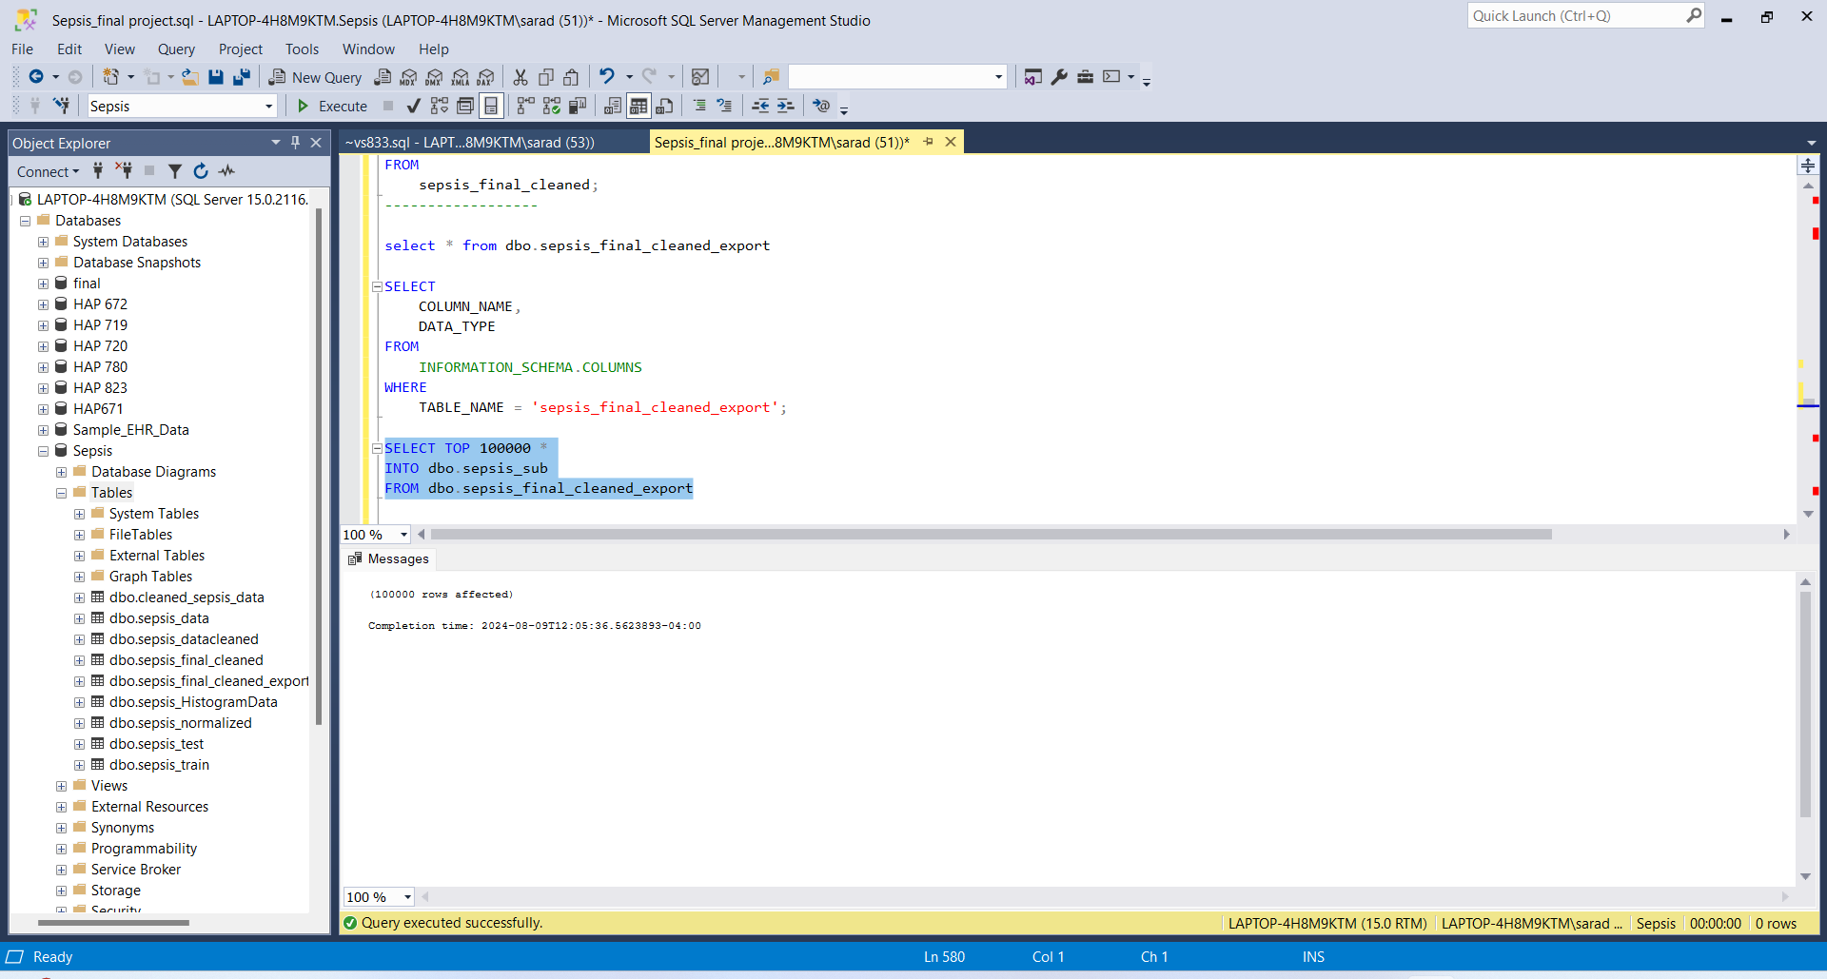
Cont.
In order to advance my analysis, I changed the essential variables to the nvarchar(max) format. This was done to verify that they were compatible with Microsoft SQL Server, which was the relational database management system that was utilized in this project. I subsequently created sepsis_final_cleaned_export, a table with vital data like sepsisType and SIRS Score. From this, I created sepsis_sub for export and Weka analysis.
The dataset was streamlined for machine learning by removing non-essential attributes such as Patient_ID, Unit1, and Unit2.
Converted key numerical features to nominal categories to align with analysis requirements: Variables transformed include SepsisLabel, Condition_temp, condition_HR, condition_Resp, condition_wbc, SIRS Score, and SepsisType.
Implemented a normalization filter on numerical attributes to enhance model accuracy and maintain data consistency, ensuring that the dataset's analytical efficacy is optimized.
These deliberate preprocessing steps were essential in preparing the dataset for robust machine learning analysis, significantly enhancing the precision and effectiveness of the developed predictive models.

Slide 12
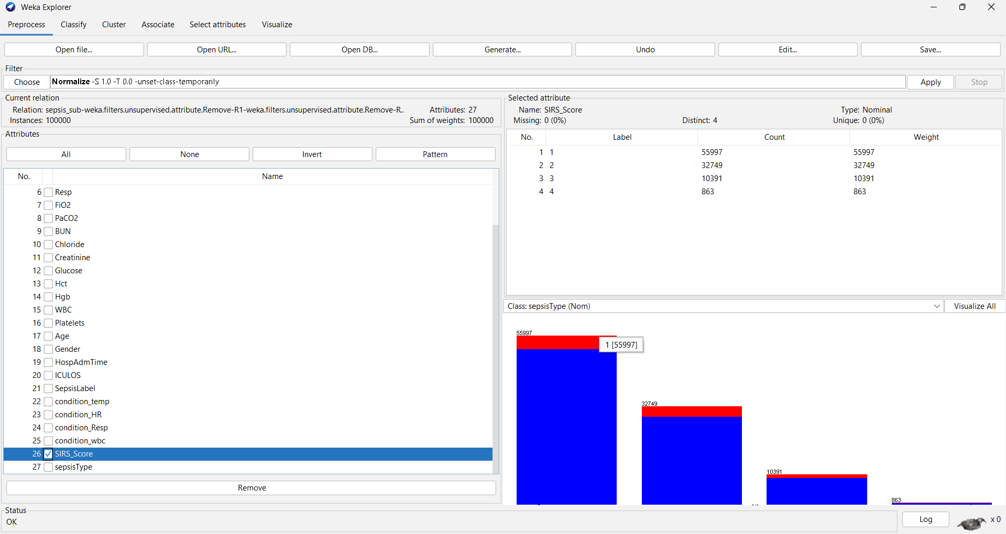

Slide 13
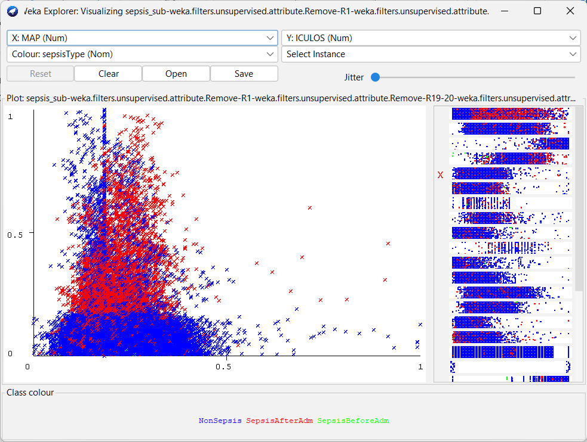
Feature Selection:
I used attribute visualization to figure out how different factors affected the definition of sepsis. Using scatter plots, patients with lower Mean Arterial Pressure (MAP) and longer ICU stays are more likely to acquire sepsis after admission. This insight is crucial for predicting sepsis and highlights the importance of these factors in patient outcomes.
For attribute selection, I retained all initially chosen attributes after assessing their significance using various methods.
I then proceeded to evaluate the performance of several machine learning algorithms in Weka Experiment, focusing on Logistic Regression, Random Forest, and Naive Bayes, and using Area under ROC as the comparison metric.
The analysis demonstrated that the Random Forest model outperformed others, achieving an Area_under_ROC of 0.99, indicating its superior predictive power for early sepsis detection. In contrast, Logistic Regression and Naive Bayes achieved ROC scores of 0.80 and 0.79, respectively.

Slide 14
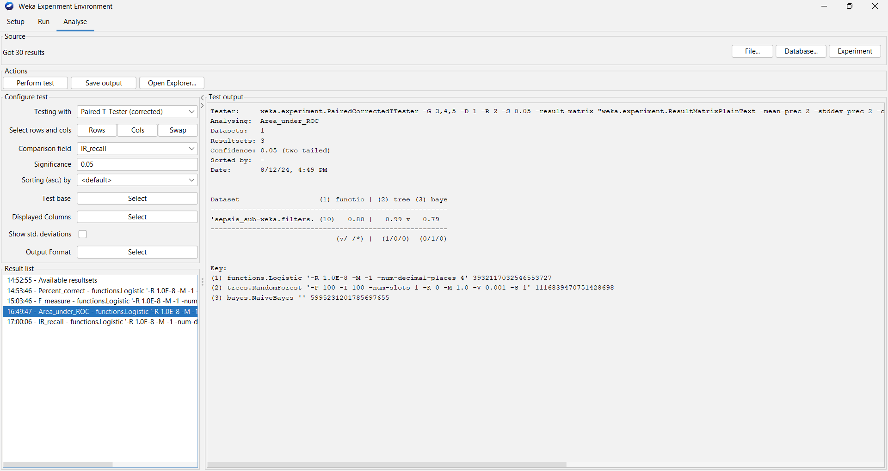
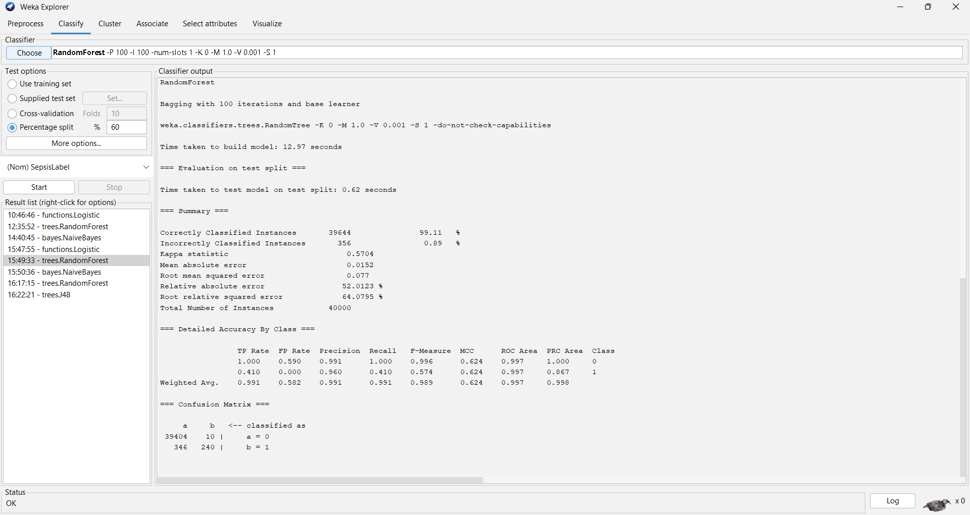
Comparison of Models & Ex. of Random Forest Model

Slide 15
Clasification – RandomForest & Logistic Regression Model – class:SepsisLabel
Logistic Regression:
=== Summary ===
Correctly Classified Instances 39489 98.7225 %
Incorrectly Classified Instances 511 1.2775 %
Kappa statistic 0.2289
Mean absolute error 0.022
Root mean squared error 0.1045
Relative absolute error 75.2725 %
Root relative squared error 86.9682 %
Total Number of Instances 40000
=== Detailed Accuracy by Class ===
TP Rate FP Rate Precision Recall F-Measure MCC ROC Area PRC Area Class
1.000 0.869 0.987 1.000 0.994 0.355 0.970 1.000 0
0.131 0.000 0.975 0.131 0.232 0.355 0.970 0.374 1
Weighted Avg. 0.987 0.856 0.987 0.987 0.982 0.355 0.970 0.990
=== Confusion Matrix ===
a b <-- classified as
39412 2 | a = 0
509 77 | b = 1
Random Forest:
=== Summary ===
Correctly Classified Instances 39644 99.11 %
Incorrectly Classified Instances 356 0.89 %
Kappa statistic 0.5704
Mean absolute error 0.0152
Root mean squared error 0.077
Relative absolute error 52.0123 %
Root relative squared error 64.0795 %
Total Number of Instances 40000
=== Detailed Accuracy by Class ===
TP Rate FP Rate Precision Recall F-Measure MCC ROC Area PRC Area Class
1.000 0.590 0.991 1.000 0.996 0.624 0.997 1.000 0
0.410 0.000 0.960 0.410 0.574 0.624 0.997 0.867 1
Weighted Avg. 0.991 0.582 0.991 0.991 0.989 0.624 0.997 0.998
=== Confusion Matrix ===
a b <-- classified as
39404 10 | a = 0
346 240 | b = 1

Slide 16
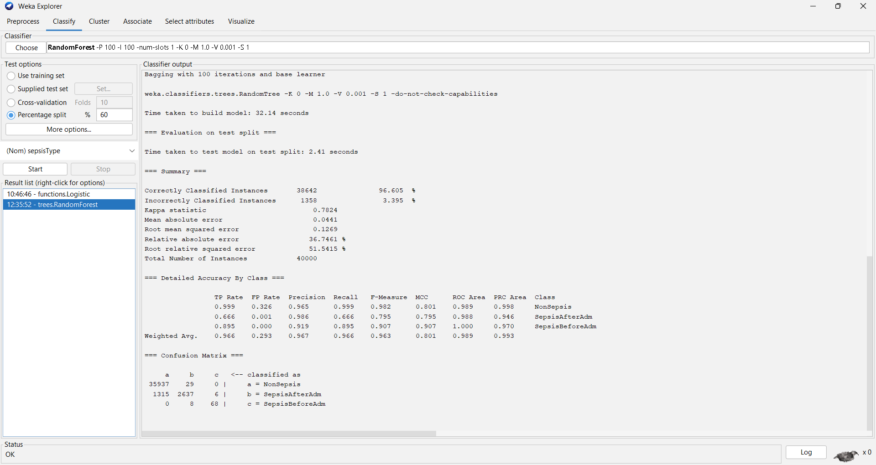
Random Forest Model – SepsisType

Slide 17
Results:
Model | ROC Area | Precision | Recall
Logistic Regression | 0.790 | 0.905 | 0.917
RandomForest | 0.989 | 0.967 | 0.966
Naïve Bayes | 0.788 | 0.889 | 0.878
Random Forest demonstrated the highest performance with a ROC area of 0.989, indicating exceptional capability to distinguish between different sepsis types.
Logistic Regression showed reliable performance with a ROC area of 0.790, solid in classifying sepsis types.
Naive Bayes achieved a reasonable performance with a ROC area of 0.788, slightly lower but still adequate.
Random Forest clearly emerged as the best-performing model in this comparison, highlighting its superior predictive power and accuracy in classifying sepsis types.

Slide 18
Model Performance Comparison for SepsisLabel Class 1 Detection
Model | ROC Area | Precision | Recall
Logistic Regression | 0.970 | 0.975 | 0.131
Random Forest | 0.997 | 0.960 | 0.410
Naive Bayes | 0.924 | 0.088 | 0.374
In evaluating the effectiveness of various predictive models for the SepsisLabel class 1, distinct differences in performance metrics such as precision, recall, and ROC area were observed. These metrics shed light on each model's ability to accurately identify sepsis cases, highlighting their strengths and limitations in handling this critical classification task.
Logistic Regression had high precision (0.975), low recall (0.131), and a ROC area of 0.970, categorizing non-sepsis cases accurately but difficulties recognizing all positive sepsis cases.
RandomForest outperformed with a precision of 0.960, recall of 0.410, and ROC area of 0.997, showing accurate sepsis case detection with few false negatives.
Naïve Bayes had lower precision (0.088), recall of 0.374, and ROC area of 0.924. It detected more sepsis patients but had a greater proportion of false positives.
After looking at accuracy, recall, and ROC measures, RandomForest was the best model for finding cases of sepsis overall.

Slide 19
Conclusion
The goal of this project was to build and test the efficacy of several machine learning models in the early diagnosis of sepsis, a major challenge with significant implications for patient care. Key findings and insights:
Developed and evaluated machine learning models including Logistic Regression, Random Forest, and Naive Bayes for early sepsis detection.
Random Forest emerged as the top performer with a ROC area of 0.997, demonstrating superior accuracy and recall, making it the most effective at distinguishing between sepsis and non-sepsis cases.
Logistic Regression showed high precision (0.975) with a ROC area of 0.970, but it faced challenges in recall, particularly with complex sepsis cases like SepsisAfterAdm and SepsisBeforeAdm.
Naive Bayes, while computationally efficient, was limited by a lower recall and a ROC area of 0.924, indicating difficulties in accurately predicting sepsis.
Although the Random Forest model has shown promise for helping healthcare personnel intervene early and improve patient outcomes, it can be improved. Adding clinical features and using advanced methods could boost model performance. Continuous refining and real-world validation are essential to keeping these models clinically effective and dependable.

Slide 20
Limitations
While this project has made significant strides in early sepsis detection, several limitations must be acknowledged that could impact the models' accuracy, applicability, and overall effectiveness.
Missing data addressed through imputation, but potential bias may still affect model accuracy.
Data imbalance, particularly between NonSepsis and Sepsis classes, may skew predictions, impacting Logistic Regression and Naive Bayes recall.
Random Forest's complexity hampers interpretability, critical for clinical use.
Feature selection may have overlooked important clinical variables that could enhance accuracy.
Dataset limitations may restrict model applicability to different patient populations or clinical settings.
Computational intensity of Random Forest challenges real-time implementation; overfitting and parameter tuning may also affect performance on new data.
Future research is needed to address these limitations and improve model reliability and effectiveness.

Slide 21
References:
Reyna, Matthew, et al. "Early Prediction of Sepsis from Clinical Data: The PhysioNet/Computing in Cardiology Challenge 2019" (version 1.0.0). PhysioNet (2019), https://doi.org/10.13026/v64v-d857.
Goldberger, A., Amaral, L., Glass, L., Hausdorff, J., Ivanov, P. C., Mark, R., ... & Stanley, H. E. (2000). PhysioBank, PhysioToolkit, and PhysioNet: Components of a new research resource for complex physiologic signals. Circulation [Online]. 101 (23), pp. e215–e220.
https://journals.lww.com/ccmjournal/fulltext/2020/02000/early_prediction_of_sepsis_from_clinical_data__the.10.aspx
https://physionet.org/content/challenge-2019/1.0.0/#description
https://www.ncbi.nlm.nih.gov/pmc/articles/PMC6964870/
https://www.mdpi.com/2077-0383/12/17/5658
https://www.beckmancoulter.com/products/hematology/early-sepsis-detection
https://mimic.mit.edu/docs/gettingstarted/
Weka - https://www.geeksforgeeks.org/how-to-use-classification-machine-learning-algorithms-in-weka/
https://physionet.org/content/challenge-2019/1.0.0/physionet_challenge_2019_ccm_manuscript.pdf

Slide 22
Thank You!

